Slide 1




CPTAC WORKSHOP
LinkedOmics: A web-based platform for cancer multi-omics data analysis, integration and comparison
01/05/2018
Suhas Vasaikar
suhas.vasaikar@bcm.edu
Dr. Bing Zhang Group
Baylor College of Medicine, Houston Texas

Slide 2
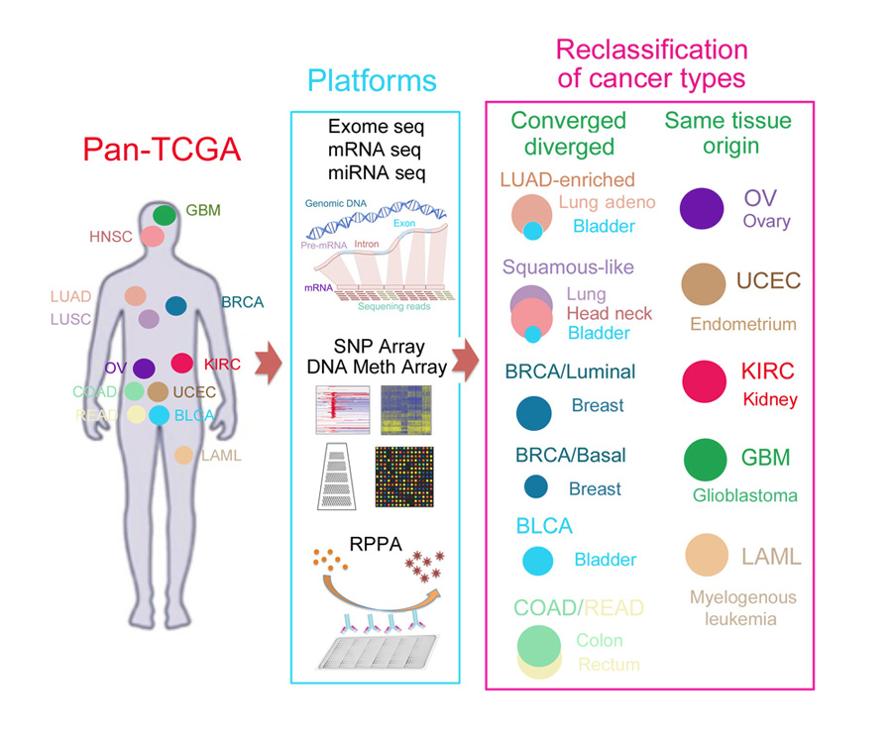
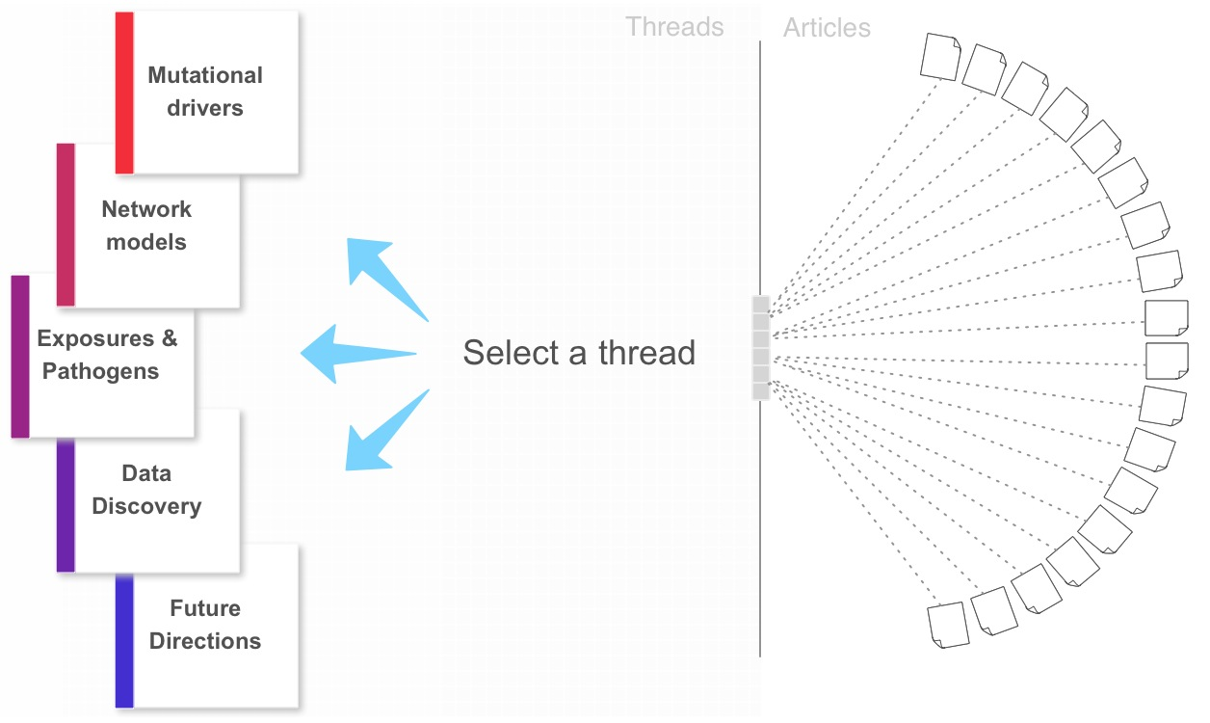
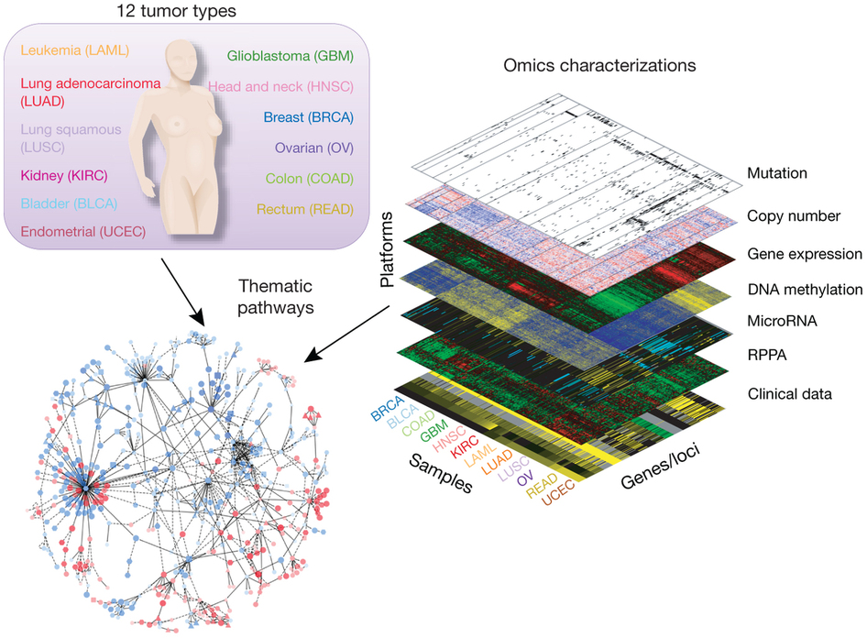
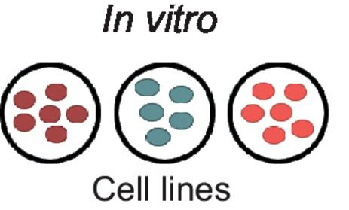
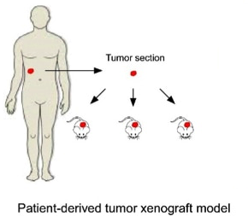
Multidimensionality of high-throughput data
PDX Samples
TCGA Cancer cohort
Experimental Study
GEO data
Public OMICS resource
Increase in dimensionality increases complexity
Is data accessible?
Is public data available in the usable format ?
With the use of available data, how to understand the relation between tumor-associated attributes in different platforms ?
How to perform across platform analysis ?
Clinical
Phospho-proteomics
Proteomics
RNA Expression
Copy Number variations
Mutation
Methylation

Slide 3
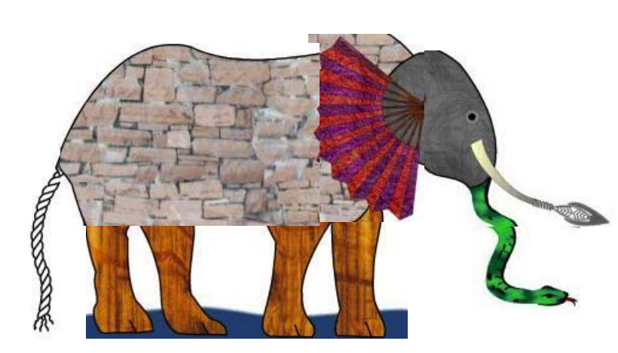
Multi-Omics Analysis (Why and How?)
Clinical
Phospho-proteomics
Proteomics
RNA Expression
Copy Number variations
Mutation
www
Methylation
Challenge is how to make genomic/proteomic data available to user and allow them to perform multi-omics / pan-cancer analysis without difficulty

Slide 4
LinkedOmics Motivation
Protein 1
Protein 2
Protein 3
……
……
……
……
……
……
……
……
Protein n
mRNA
Copy number
Platforms
mRNA
Protein
PIK3CA mutation
Protein
/MS proteomics
Samples
Mir-200C expression
Attributes
Pathway
Discover, compare, and interpret
omics associations
TCGA
Survival

Slide 5
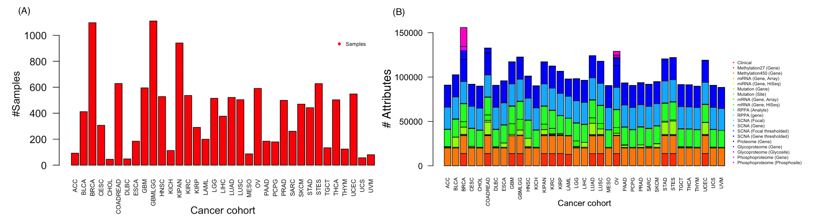
Data Source
Omics data for 32 cancer cohorts downloaded from TCGA (version 2016_01_28). The platform includes data from methylation (gene level), copy number variation (focal and gene level), mutation (site and gene level), mRNA expression (gene level), miRNA expression (gene level), RPPA (analyte and gene level) and clinical data (phenotype) related to primary tumors from 11,158 patients. It also includes mass spectrometry-based proteomics data generated by the Clinical Proteomic Tumor Analysis Consortium (CPTAC) for TCGA breast, colorectal, and ovarian tumors.

Slide 6
Data Organization and Analysis Modules
32 cancer types; 11,158 patients; >1 billion data points
TCGA/CPTAC
LAML, ACC, BLCA, LGG, BRCA, CESC, CHOL, COAD, COADREAD, ESCA, GBM, HNSC, KICH, KIRC, KIRP, LIHC, LUAD, LUSC, DLBC, MESO OV, PAAD, PCPG, PRAD, READ, SARC, SKCM STAD, TGCT, THYM, THCA, UCS, UCEC, UVM
LinkFinder
Within- and cross-omics associations
LinkInterpreter
Pathway and network analysis
LinkCompare
Multi-omics and pan-cancer analysis

Slide 7

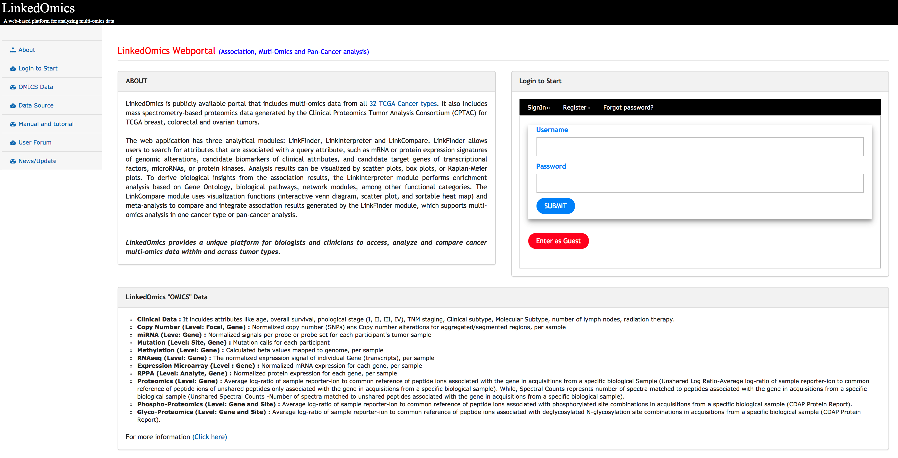
Webportal
www.linkedomics.org

Slide 8
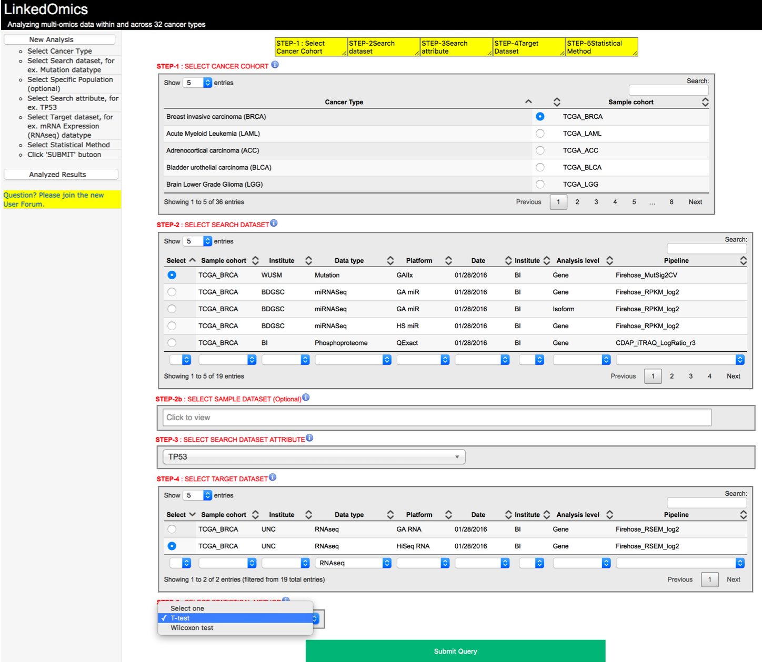
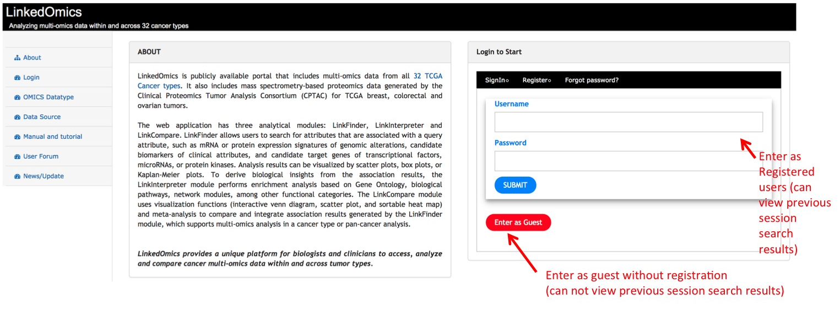
Overview of “LinkedOmics” webportal
www.linkedomics.org
Query Panel has 5 steps
Step1: Select Cancer Type
Step2: Select Search dataset, for ex. Mutation datatype
Step2b: Select Specific Population (optional)
Step3: Select Search attribute, for ex. TP53
Step4: Select Target dataset, for ex. mRNA Expression (RNAseq) datatype
Step5: Select Statistical Method
Click 'SUBMIT' button

Slide 9
Lets explores some examples

Slide 10
Example1
Cancer cohort
In Prospective Uterine Corpus Endometrial Carcinoma (UCEC), how clinical phenotype serous associated with gene expression?
Search Dataset
Search Attribute
Target Dataset

Slide 11
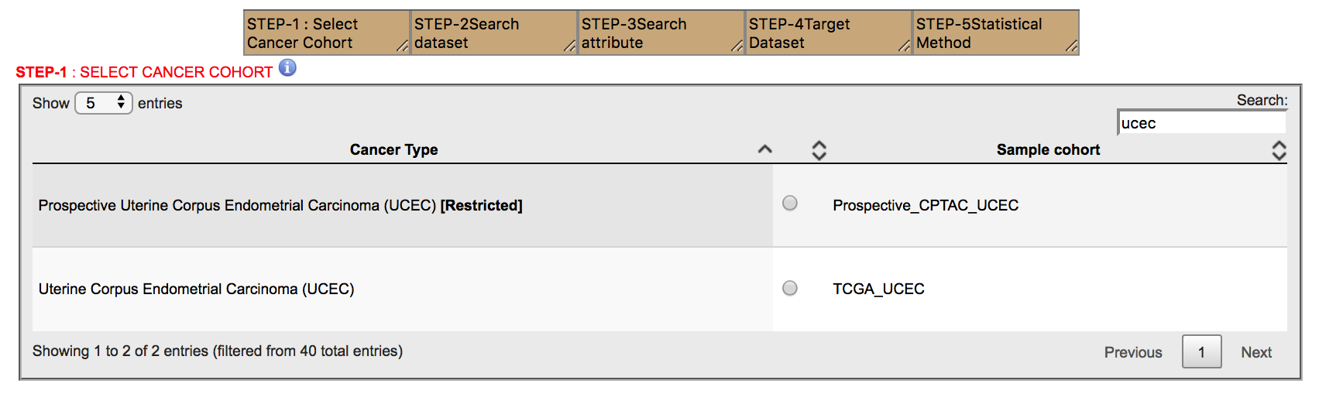
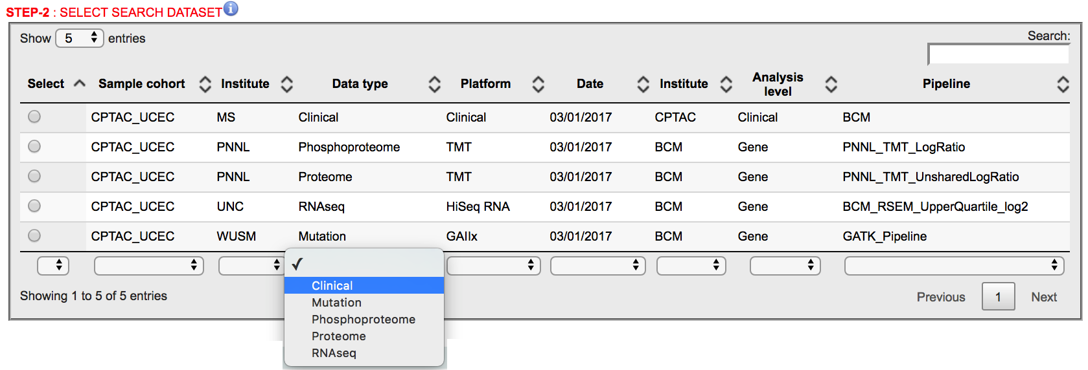
Select the cancer cohort “CPTAC UCEC”

Slide 12
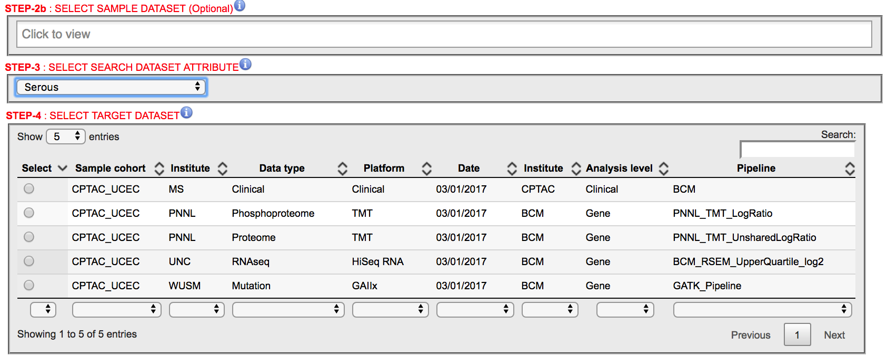
Select “Search attribute” and “Target Dataset”

Slide 13
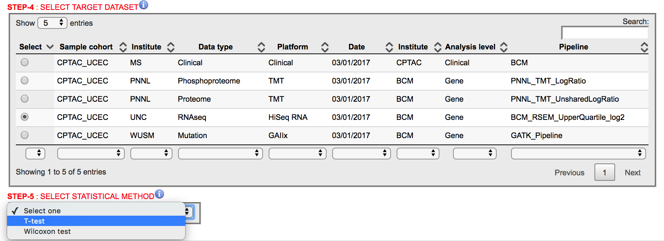
Select “Statistical test”

Slide 14
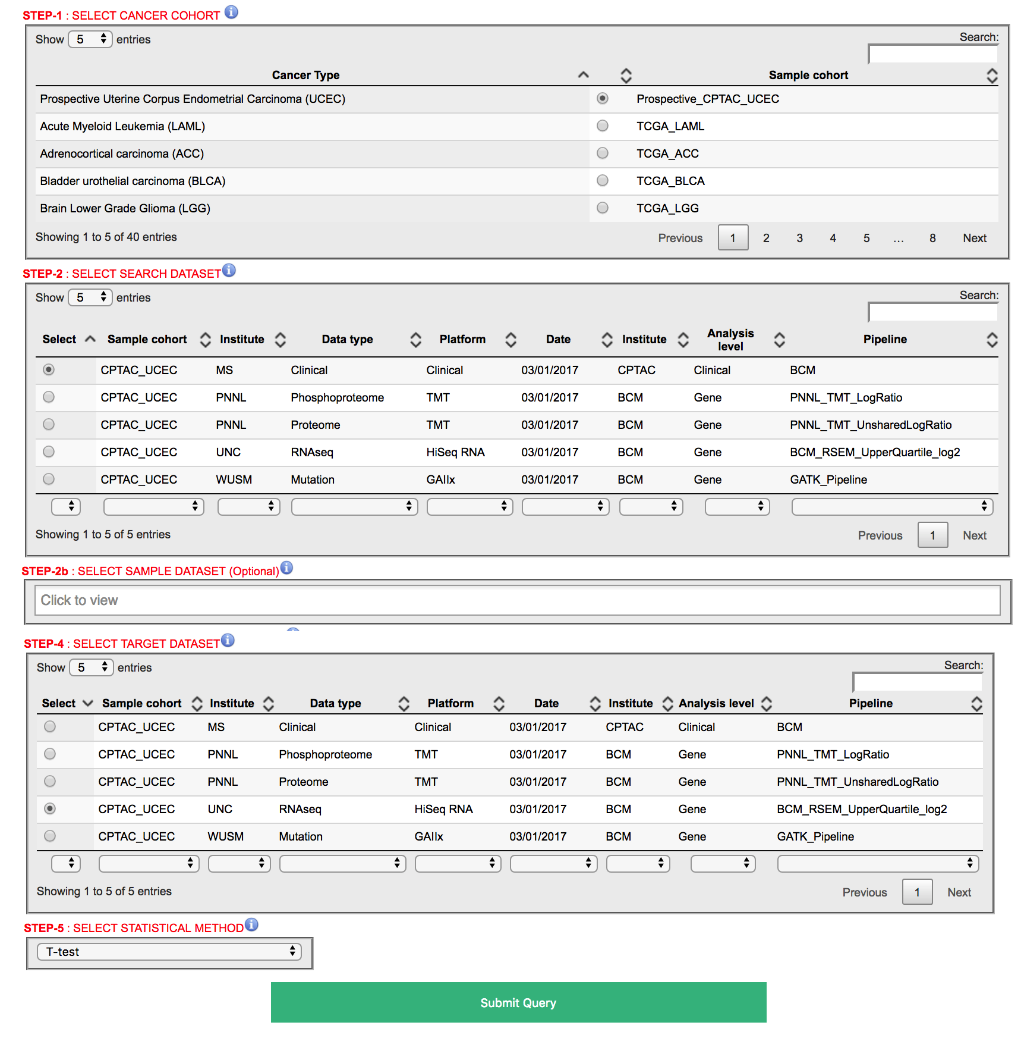

Slide 15
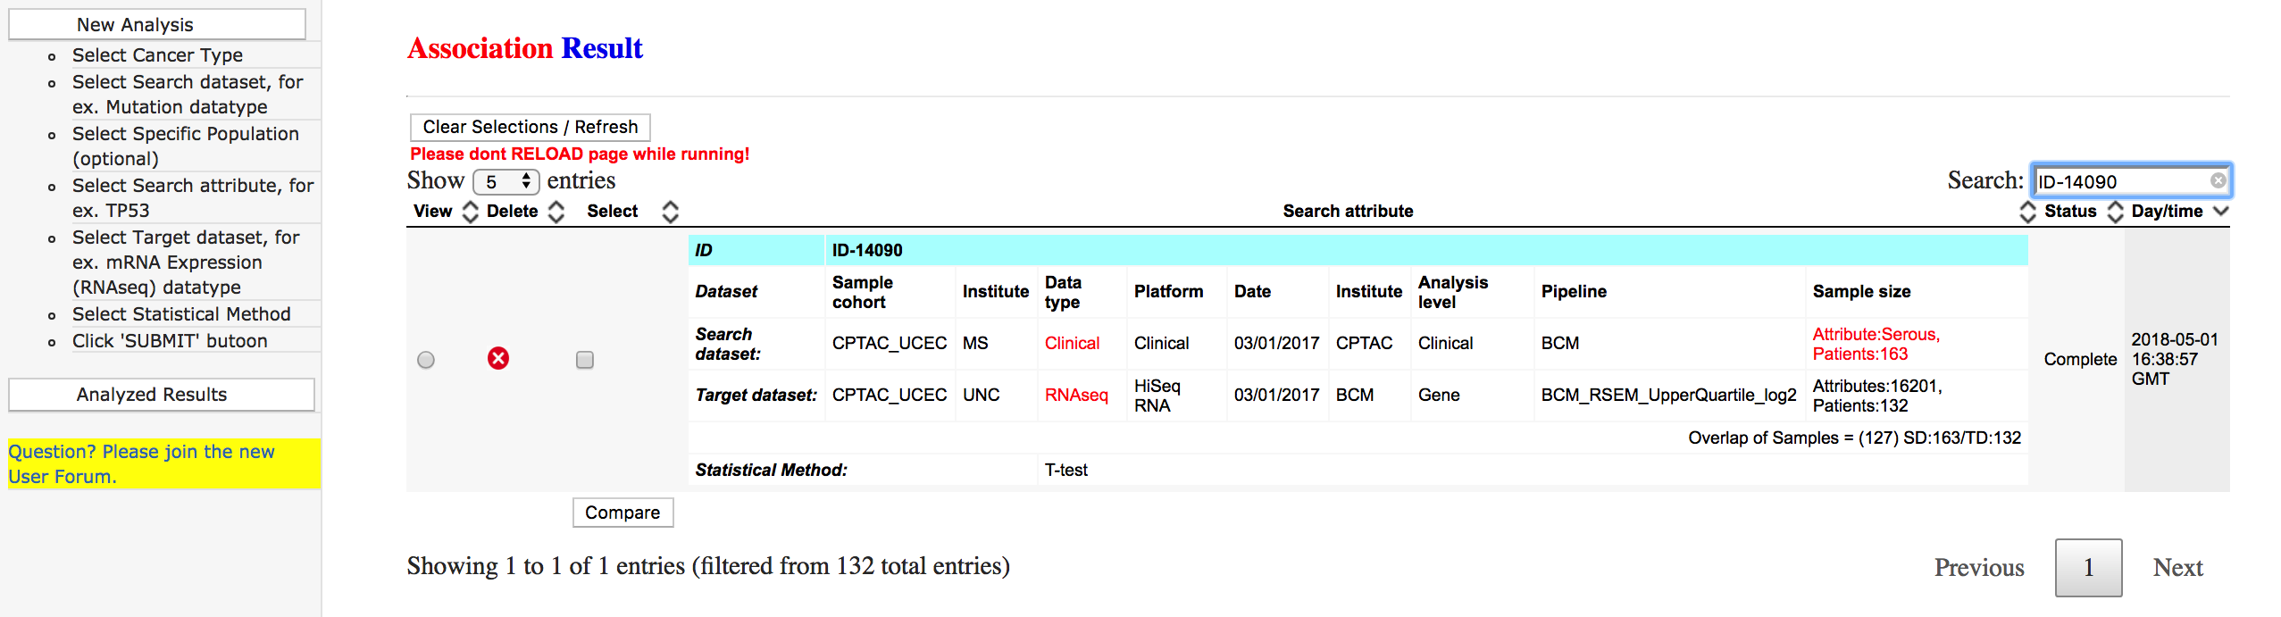
Serous phenotype associated with gene expression
New analysis to START
View Results
Search history will be shown

Slide 16
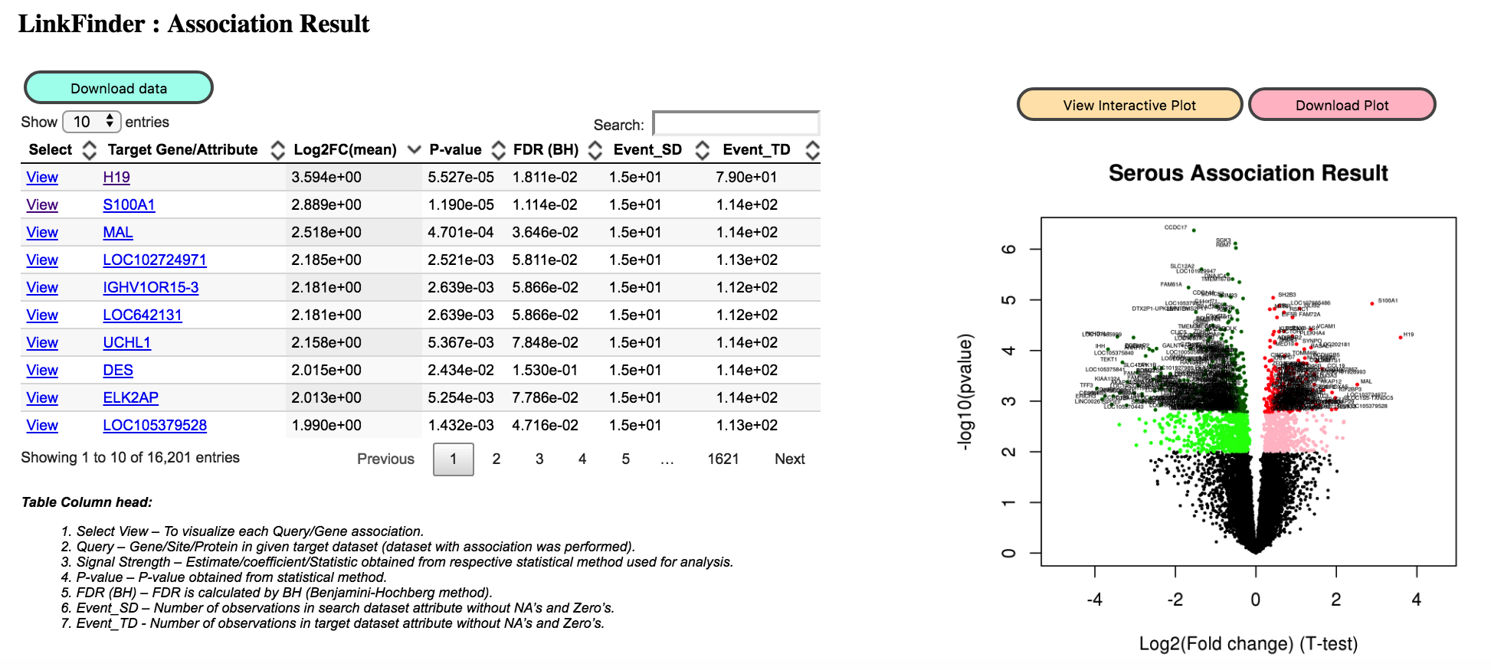
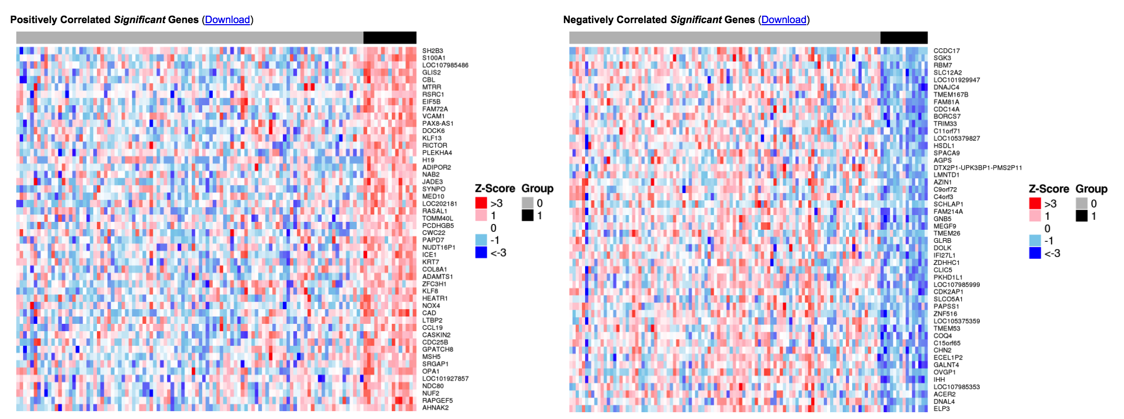
Serous phenotype associated with gene expression

Slide 17
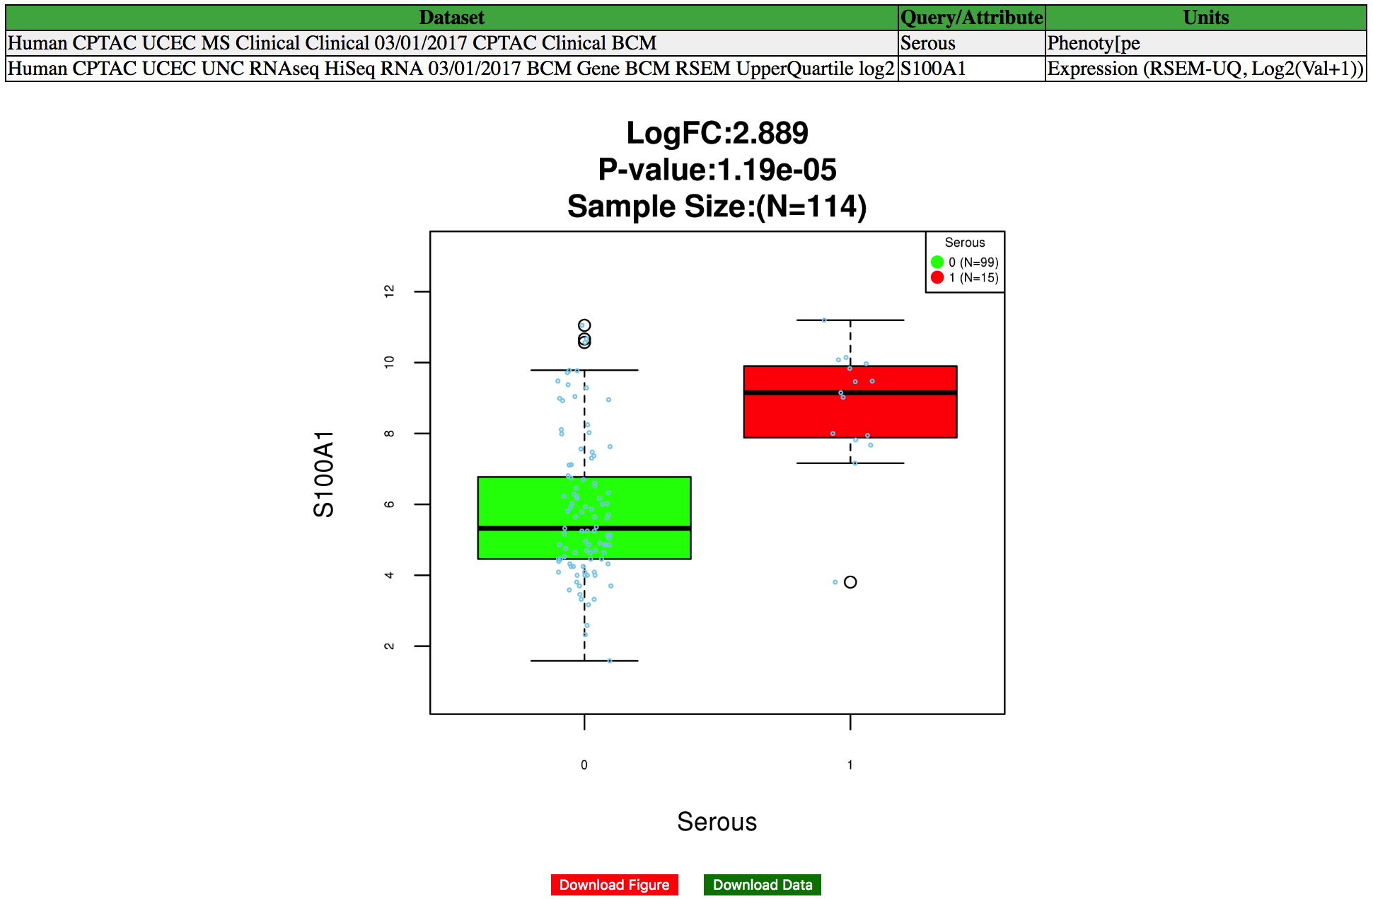

Slide 18
LinkInterpreter
Enrichment analysis

Slide 19
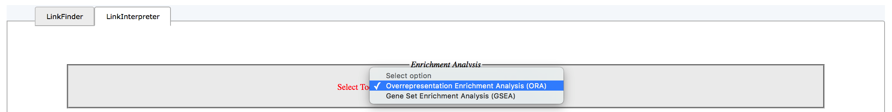
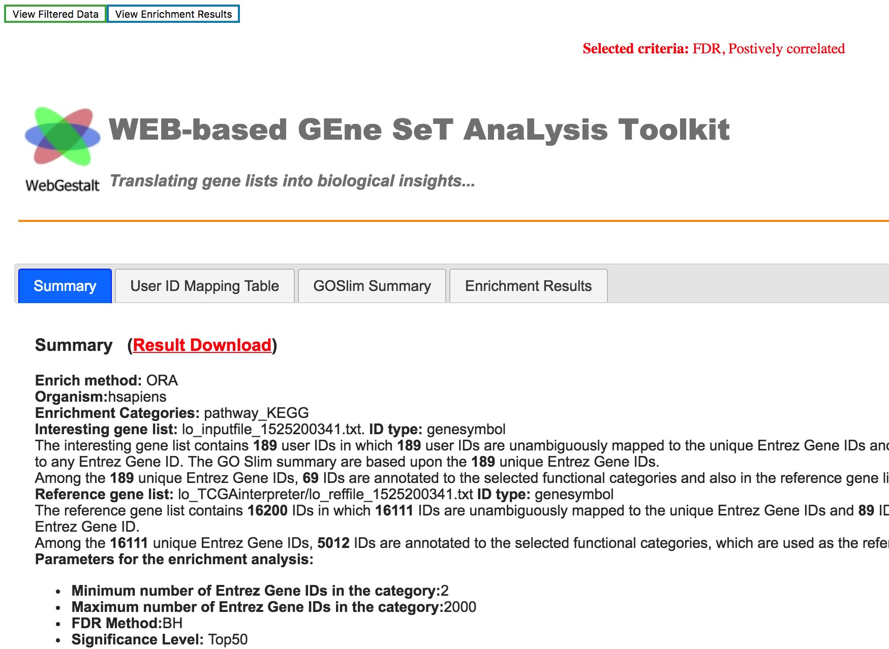
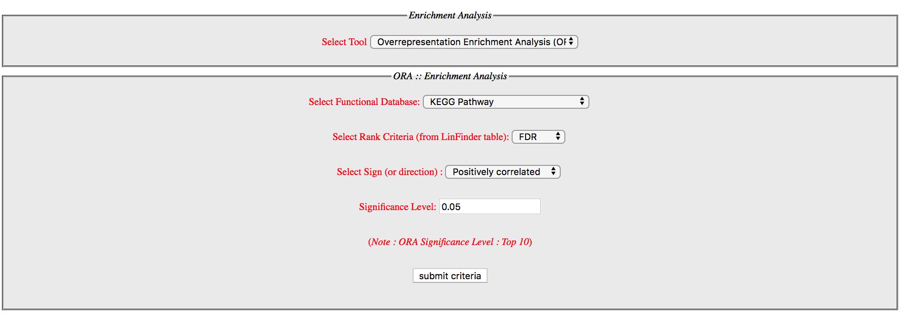

Slide 20
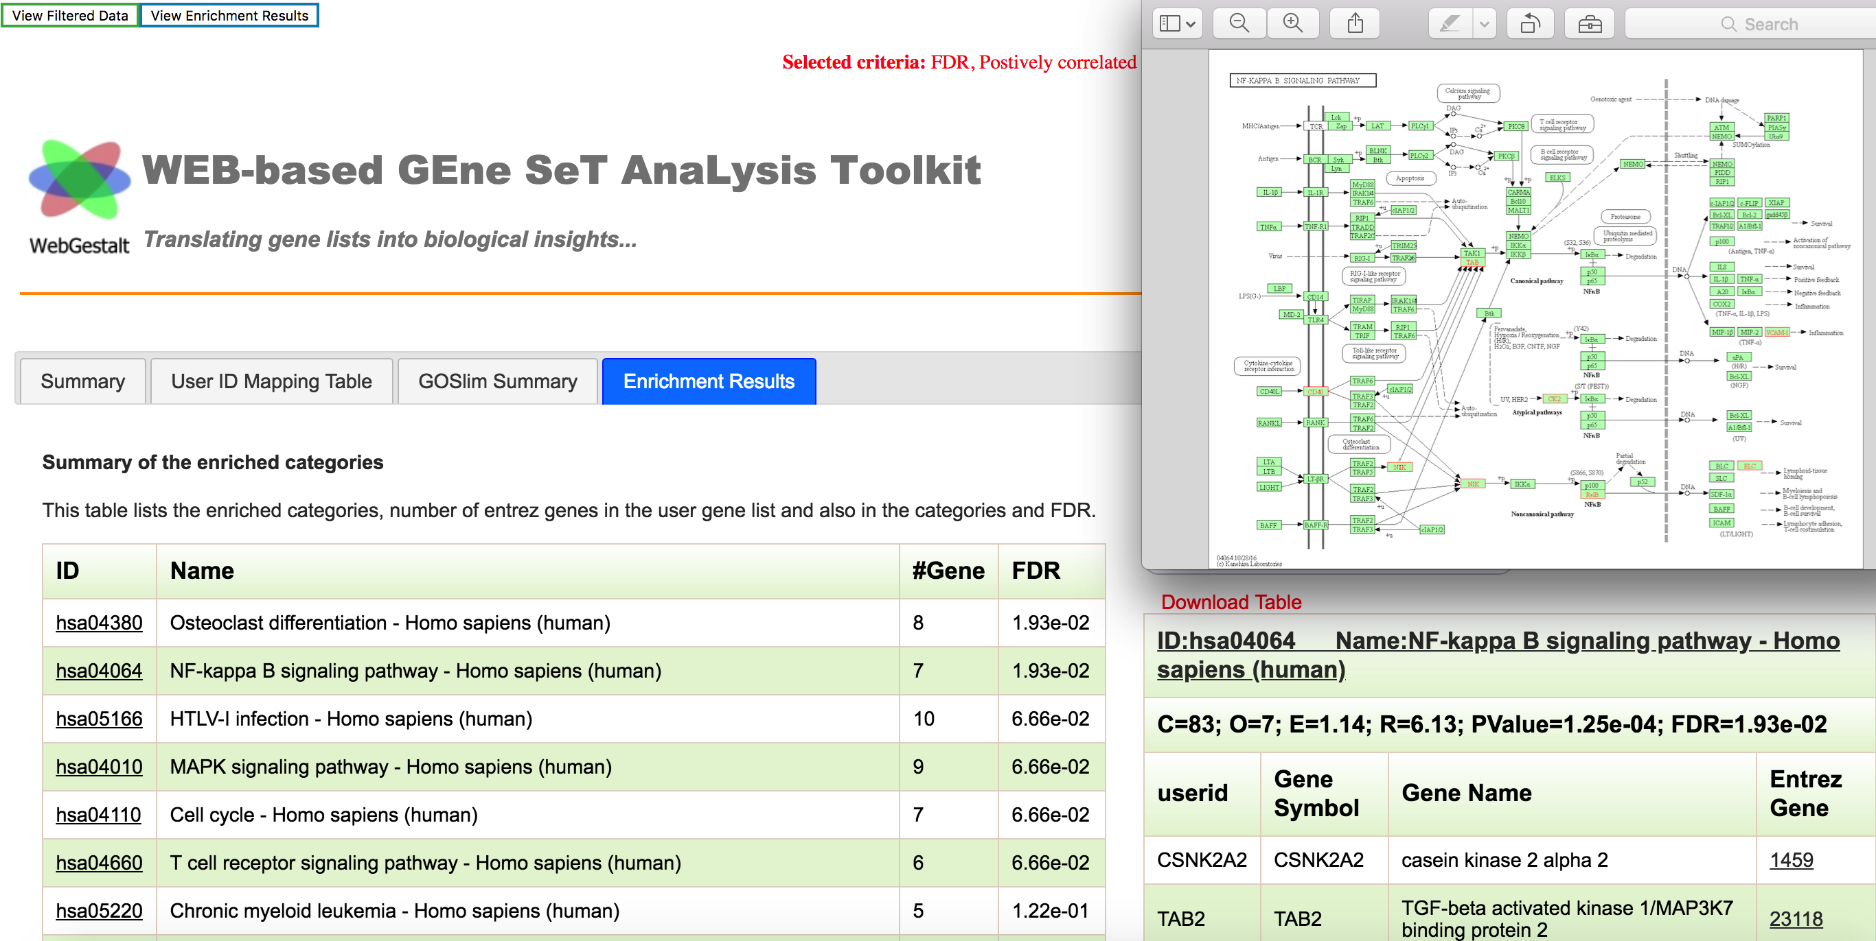

Slide 21
Lets explores more cases
Case example: Clinical Serous phenotype association with Proteomics
  Perform association analysis using LinkFinder
  Select the cancer cohort: CPTAC_UCEC
  Select search dataset : Clinical Data type
  Optional, Select population [do not select in this example]
  Select attribute/phenotype of interest: Serous
  Select target dataset with which possible pair-wise association analyses will be calculated: HiSeq RNA Data Type (gene level)
  Select statistical method: T-test
  Click SUBMIT QUERY

Slide 22
Lets explores more cases
Case example: JAK1 protein association with other proteins
  Perform association analysis using LinkFinder
  Select the cancer cohort: CPTAC_UCEC
  Select search dataset : Proteome
  Optional, Select population [do not select in this example]
  Select attribute/phenotype of interest: JAK1
  Select target dataset with which possible pair-wise association analyses will be calculated: Proteome
  Select statistical method: Pearson
  Click SUBMIT QUERY
  LinkInterpreter
  Select GSEA
  Select WikiPathway
  view Significant enrichment and Map

Slide 23
Lets explores more cases
Case example: AKT1 phosphpoprotein association with other phosphoproteins expression
  Perform association analysis using LinkFinder
  Select the cancer cohort: CPTAC_UCEC
  Select search dataset : Phosphoroteome
  Optional, Select population [do not select in this example]
  Select attribute/phenotype of interest: AKT1
  Select target dataset with which possible pair-wise association analyses will be calculated: Phosphoroteome
  Select statistical method: Spearman
  Click SUBMIT QUERY
  LinkInterpreter
  Select GSEA
  Select TF pathway
  view Significant TFs

Slide 24
LinkCompare
Compare “Concordance” or “Discordance” among or across cancer omics platform

Slide 25
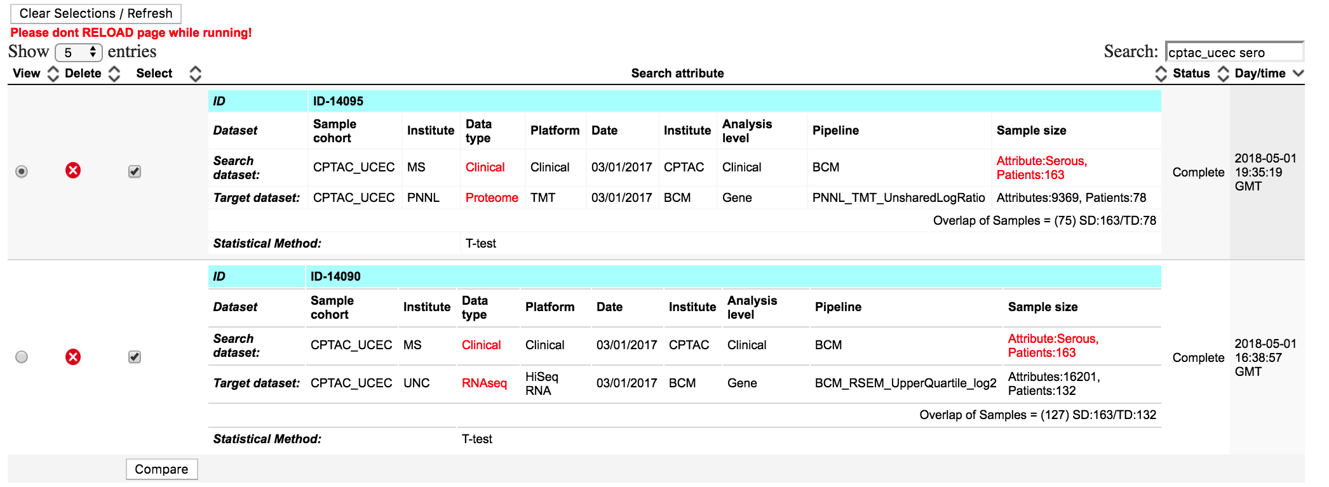
Compare serous association in RNAseq and Proteomics
Click to Compare

Slide 26
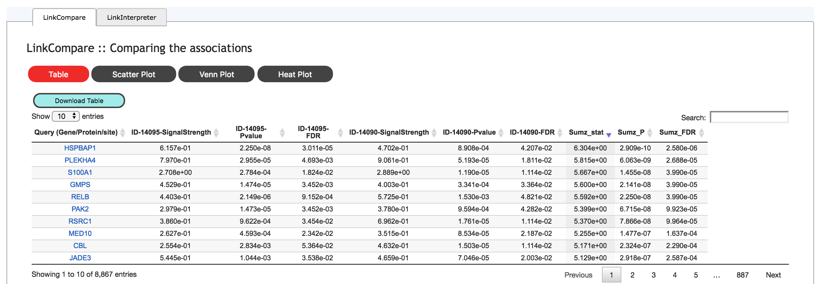
Results shown in Table with metaSignificance value

Slide 27
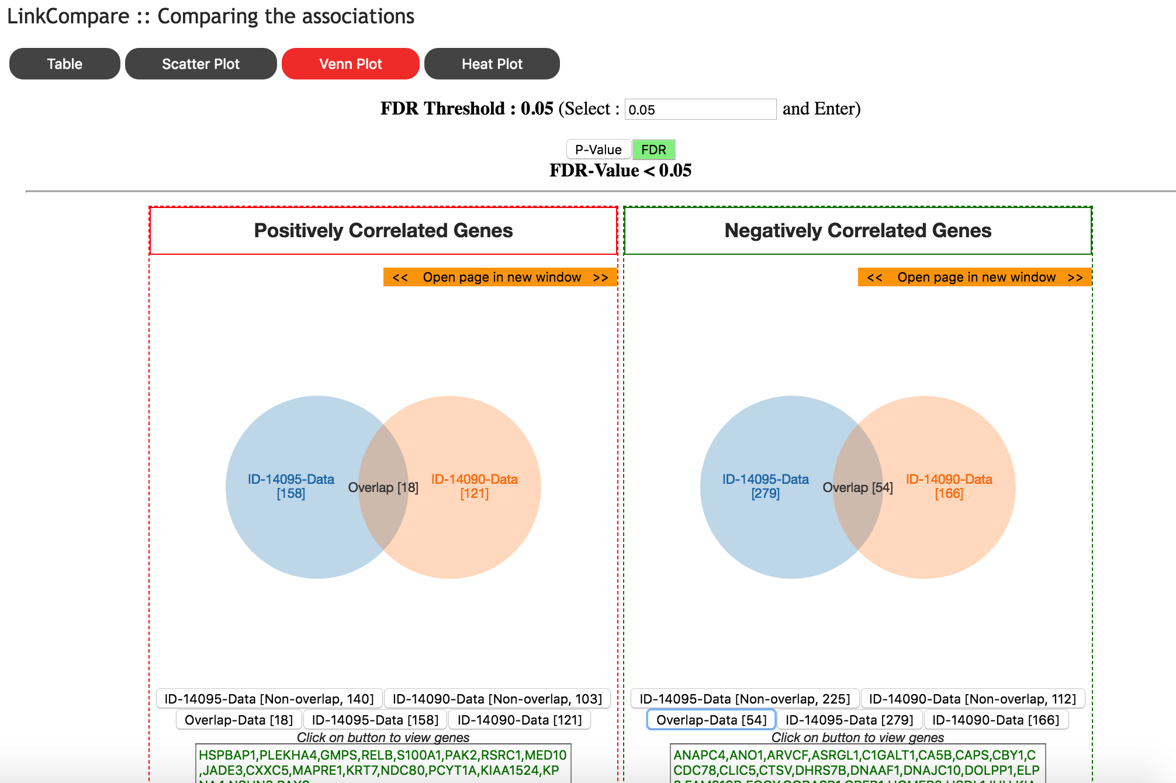
Result comparison and visualization
18
54
Proteome RNAseq
Proteome RNAseq

Slide 28
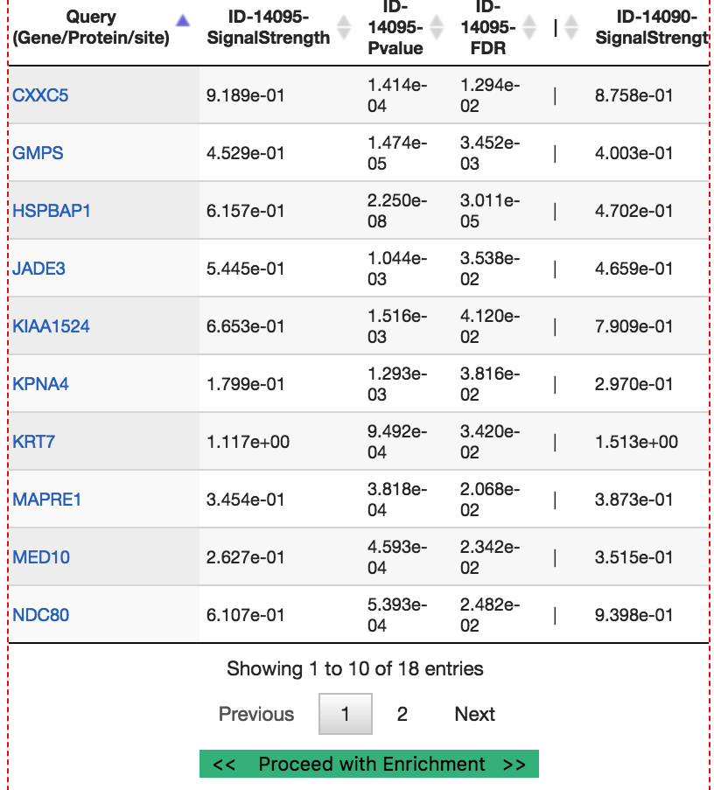
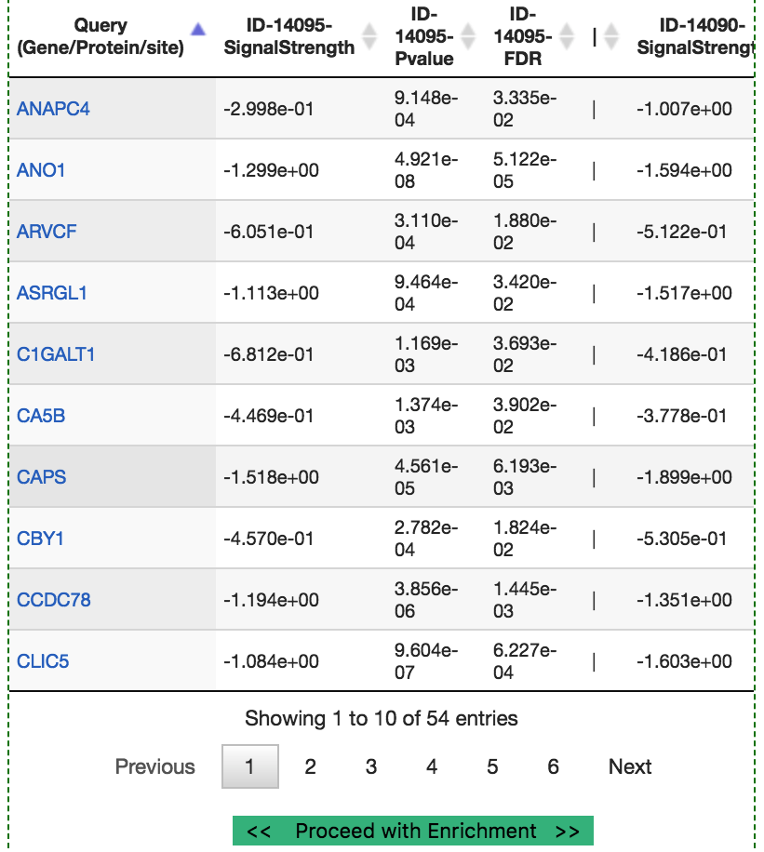
Significant genes in both platforms

Slide 29
Thank You
for
Joining session

